Slide 1
DIABETIC FOOT

Slide 2
HISTORY AND PHYSICAL EXAMINATION
HISTORY
Episodes of ulceration
Prior amputations
Impaired vision
Renal history
Presence of paresthesia or numbness
Symptoms of claudication

Slide 3
HISTORY AND PHYSICAL EXAMINATION
PHYSICAL EXAMINATION
Patient’s footwear
Inspection of the patient’s feet
Contracture of the gastrocnemius
Vascular situation
Neurologic examination

Slide 4
ULCER CLASSIFICATION
Wagner Classification for Foot Ulcers
0: Skin at risk
I: Superficial ulcer
II: Exposed tendon and deep structures
III: Deep ulcers with abscess or osteomyelitis
IV: Partial gangrene
V: More extensive gangrene

Slide 5
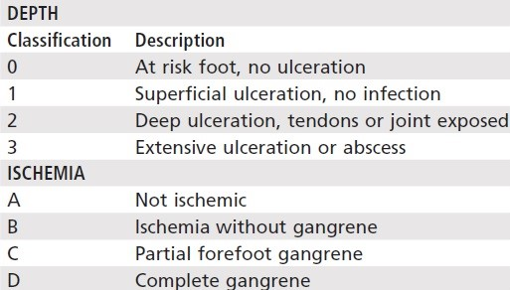
ULCER CLASSIFICATION
Brodsky Depth-Ischemia Classification for Foot Ulcers

Slide 6
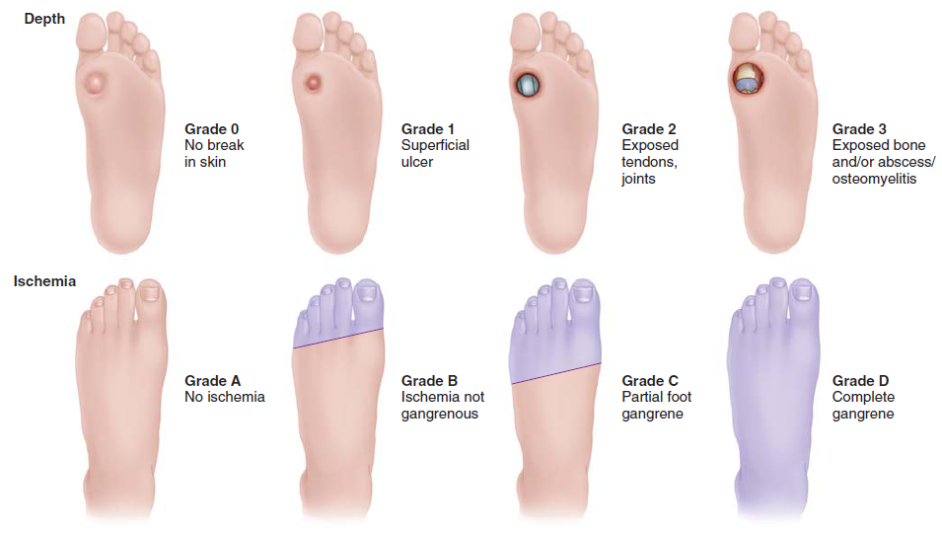
ULCER CLASSIFICATION
Brodsky Depth-Ischemia Classification for Foot Ulcers

Slide 7
TREATMENT
The most standard treatments are debridement and off-loading of the affected area.
Because of the complexities of treating diabetic feet, including impaired blood supply, osteoporotic bone, and neuropathy, a multidisciplinary approach is most beneficial.
Expertise often is needed from subspecialists in orthopaedics, vascular surgery, infectious disease, endocrinology, and wound nursing.

Slide 8
TREATMENT
Any evidence of ischemia, venous stasis, or pressure from shoes must be identified and treated.
Systemic factors, including glucose control, smoking, and diet, should be controlled to optimize the wound-healing environment.
All areas surrounding the wound should be inspected for peri-wound callus and necrotic tissue.

Slide 9
TREATMENT
Using the Wagner classification of foot ulcers:
Grade 0 ulcers should be treated with serial examinations, patient education, and accommodative footwear.
Grade I ulcers can be treated with debridement in the clinic and off-loading with a total contact cast, walking brace, or other custom footwear.

Slide 10
TREATMENT
Using the Wagner classification of foot ulcers:
Grade II ulcers require surgical debridement, culture-specific antibiotics, and off-loading with total contact casting.
Grade III ulcers require surgical debridement or partial amputation with off-loading and culture specific antibiotics.

Slide 11
TREATMENT
Using the Wagner classification of foot ulcers:
Grades IV and V ulcers require local or larger amputation based on the extent of infection.

Slide 12
TREATMENT
Debridement;
whether done in the clinic or operating room, involves sharply removing all hypertrophic callus and nonviable tissue.
All infected tissue, including soft tissue and bone, must be excised.
This decreases the bacterial load and the detrimental cellular breakdown products such as matrix metalloproteinases from the wound bed.

Slide 13
PATIENT EDUCATION
Patient education for diabetic patients has been shown to be cost-effective, improve patient quality of life, and reduce the risk of lower extremity amputation by 50% to 85%.
Feet should be inspected daily, and any signs of erythema, ulceration, or nail problems should be brought to the attention of the care provider.

Slide 14
PATIENT EDUCATION
Feet should be bathed daily with mild soap and a soft brush for the areas around the nails.
When drying the feet, attention should be paid to the web spaces because these areas often trap moisture. If the web spaces remain overly moist, lamb’s wool may be placed in between the toes to avoid maceration.

